Slide 1
Crimes in US Communities Analysis
Data 621 – Final Project
Gabriel Santos, Josh Iden, Avery Davidowitz,
Mathew Katz, Tyler Brown, John Ledesma
May 07 - 2023

Slide 2
Abstract
This is a dataset of 2018 US communities, demographics of each community, and their crime rates. The dataset has 146 variables where the first four columns are community/location, the middle features are demographic information about each community such as population, age, race, income, and the final columns are types of crimes and overall crime rates.
The goal of the project is to understand where violent crime occurs in terms of the socioeconomic and demographic characteristics of the regions. The features can help predict ahead of time where violent crime is likely to occur through predictive models that can quantify the risk associated with a region.
Notes:
The

Slide 3
Introduction
The approach to the problem of crime in the different states of the United States implies the investigation and analysis of the crime rates in each state, as well as the factors that may be contributing to said rates.
One of the factors that has been studied in relation to crime is the socioeconomic level of a community.
There is evidence to suggest that communities with low socioeconomic levels have a higher incidence of crime compared to more prosperous communities.
Other socioeconomic factors, such as unemployment, poverty, lack of educational and job opportunities, have also been linked to increased risk of crime. These factors can negatively affect people's quality of life and increase their vulnerability to crime.
The analysis that we are going to carry out in this work could be useful to build predictive models that better help in urban planning and crime reduction.

Slide 4
Dataset Overview
The dataset selected for this analysis is 'Crimes in US Communities Dataset' - Michael Bryant (Owner).
Resource: https://www.kaggle.com/datasets/michaelbryantds/crimedata?select=crimedata.csv
We have a very complete dataset. According to each state we can see data such as:
population for community, percentage of population in 4 age groups, percentage of population according to race, percentage of people using public transit for commuting, and many more data that will allow us to carry out a good analysis.
This is a dataset of 2018 US communities. Numeric-decimal data types have been normalized to two decimal places (0.00).
Our target variable is 'Violent Crimes by Population', (GOAL attribute).
Our crime dataset has 128 attributes.

Slide 5
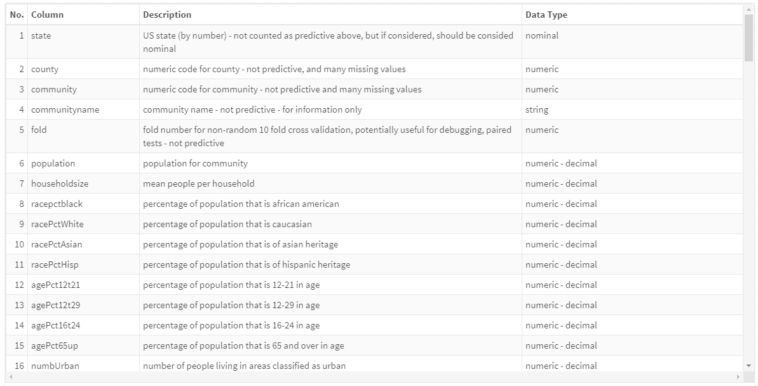
Description of each variable and the data type

Slide 6
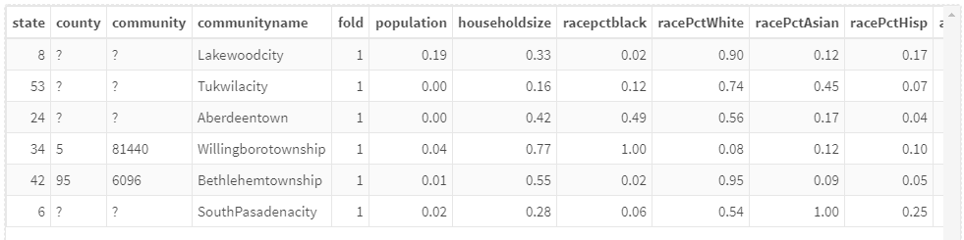
Community data
In the following table, we can see for each state and community, population. The percentage of population according to age, race, total number of violent crimes per 100K population and other data that may be useful for our analysis.

Slide 7
Preparation & Exploration
Dataset:
The dataset has 1994 observations and 128 variable.
We can see that there are missing values in the dataset, we are going to convert these data into 'NA' in order to carry out our analysis.

Slide 8
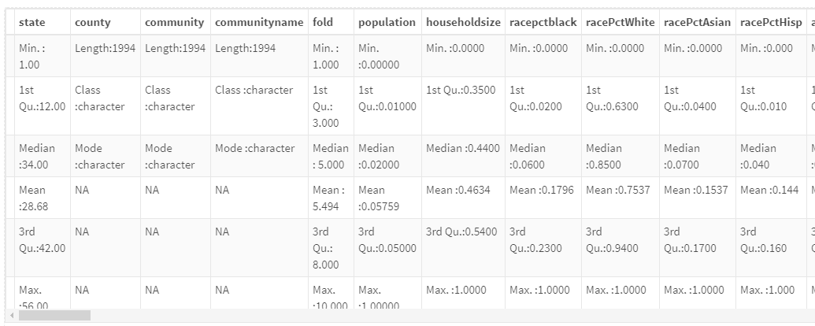
Summary of the variables
A summary of some variables:

Slide 9
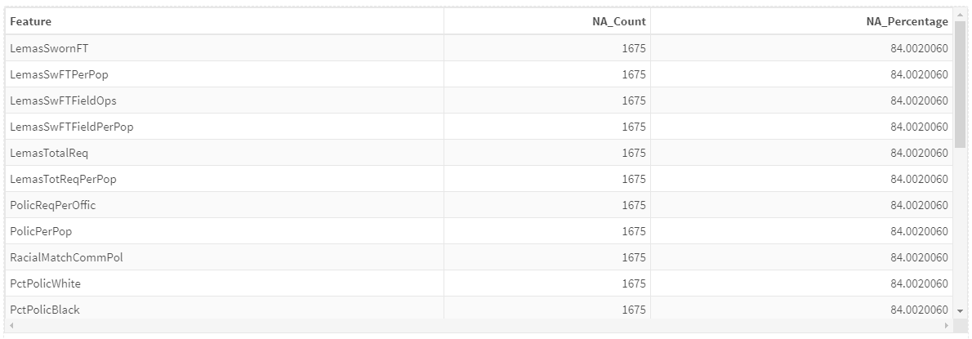
Missing data we have for each attribute

Slide 10
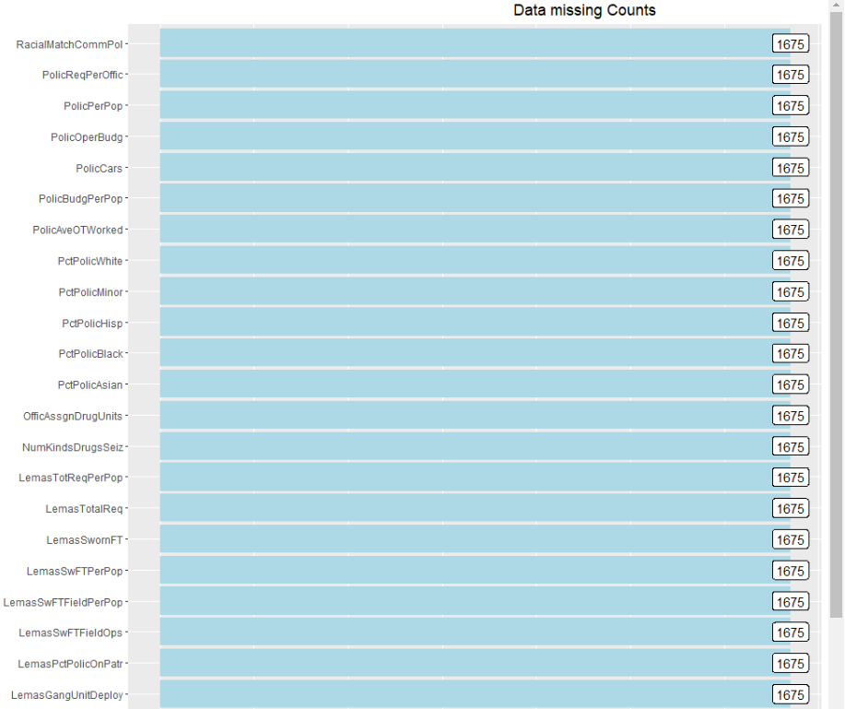
Missing data we have for each attribute
Reviewing the variables that have missing data, we find that 2 variables have approximately 58.8% of missing data and 22 variables have 84% of missing data.

Slide 11
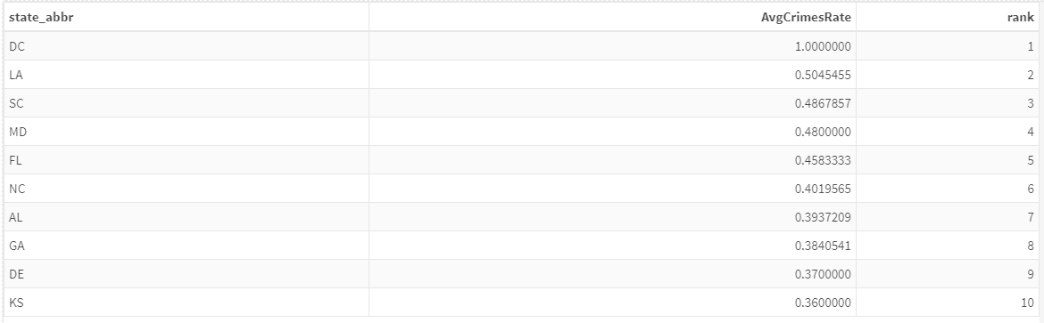
Exploratory Data Analysis
Violent Crime Rate Analysis:
we can see the 10 states with the highest rate of violent crimes:

Slide 12
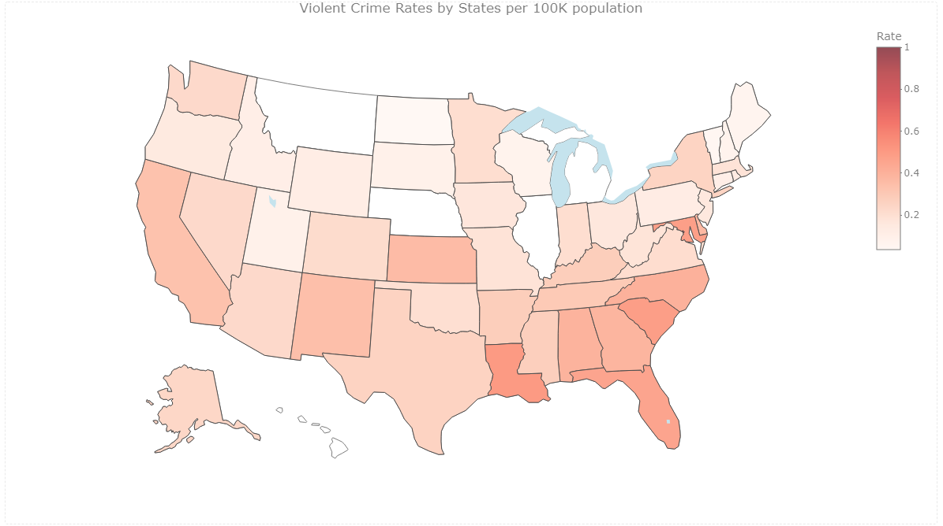
Violent Crime Rates by States per 100K population

Slide 13
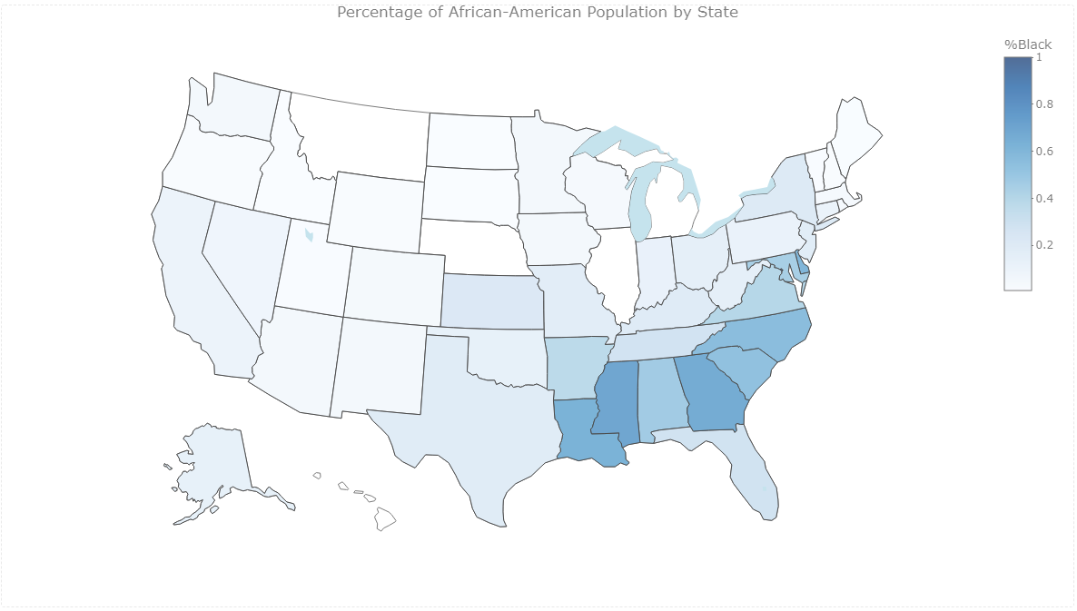
African-American population Analysis

Slide 14
African-American population Analysis
District of Columbia - We can see that the District of Columbia ranks first in both crime rate and the percentage of African-American people. We might think that there is a relationship between these two aspects.
The crime rate in a state is not necessarily related to the perception of race based on the percentage of the population of a particular race. While the crime rate may be higher in some urban areas than others, there is no evidence to suggest that the crime rate is related to the race of the population.

Slide 15
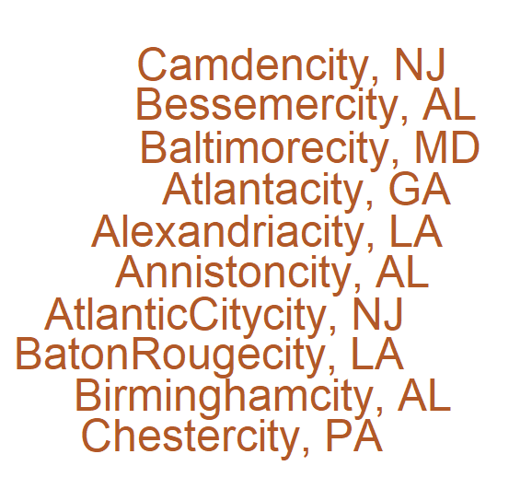
Most dangerous communities
The city of Camden in the state of New Jersey is the one that occupies the first place with the highest rate of violent crimes. In the top 10 communities with the most violent rates, we have three communities located in the state of Alabama.

Slide 16
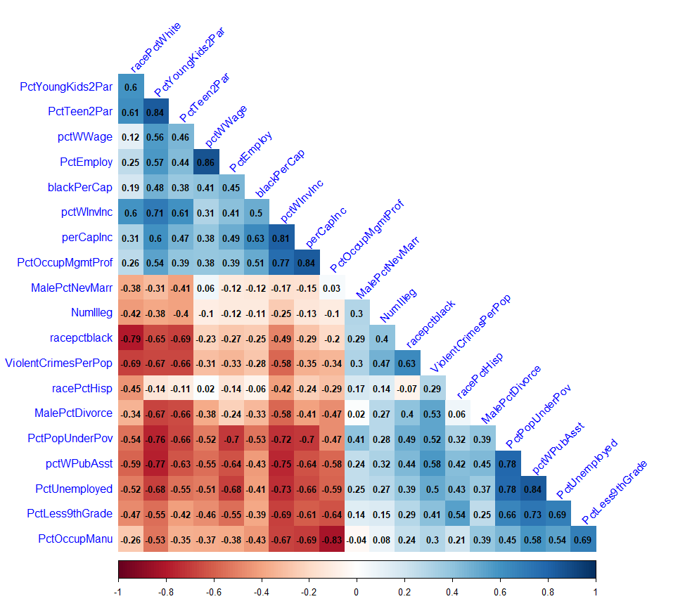
Correlation

Slide 17
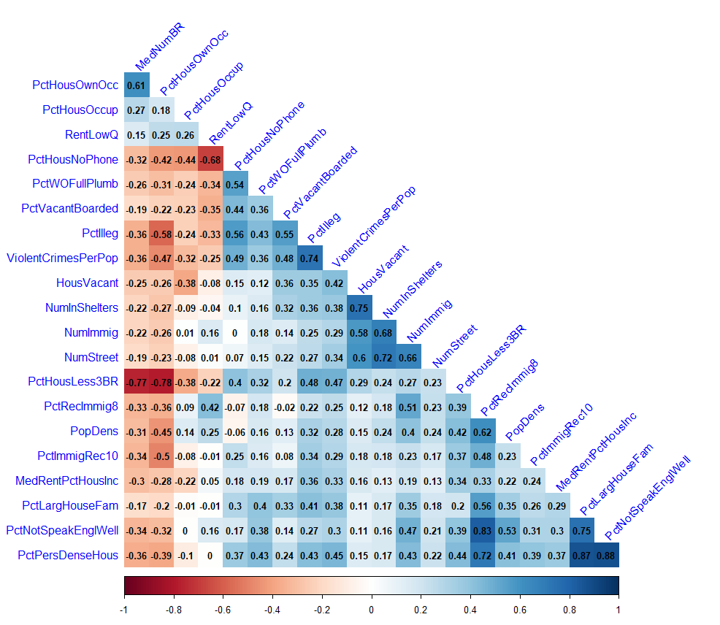
Correlation

Slide 18
Correlation
We can observe that some variables influence the rates of violent crimes are:
racepctblack: percentage of population that is african american
MalePctDivorce: percentage of males who are divorced
PctPopUnderPov: percentage of people under the poverty level
pctWPubAsst: percentage of households with public assistance income in 1989
PctUnemployed: percentage of people 16 and over, in the labor force, and unemployed
PctLess9thGrade:percentage of people 25 and over with less than a 9th grade education
PctOccupManu: percentage of people 16 and over who are employed in manufacturing
PctHousNoPhone: percent of occupied housing units without phone (in 1990, this was rare!)
PctHousLess3BR: percent of housing units with less than 3 bedrooms

Slide 19
Modeling
Training and Test Partition of data:
Let's partition the training dataset. We will use 75% of the data for training and 25% for validation.
Ridge Regression:
Train coefficient: 0.8163905
Test coefficient: 0.7438792
LASSO Regression:
Train coefficient: 0.8172372
Test coefficient: 0.7475433
Elastic Net Regression:
Train coefficient: 0.8171584
Test coefficient: 0.7475421

Slide 20
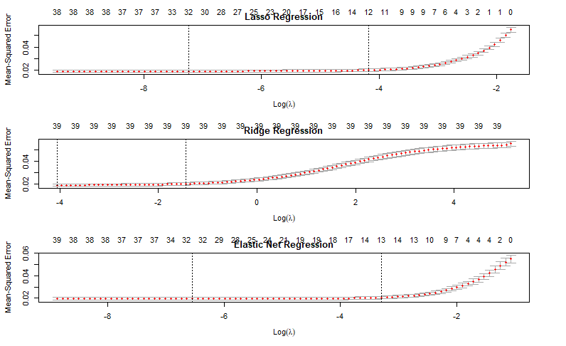
MSE: Lasso Regression vs Ridge Regression vs Elastic Net Regression

Slide 21
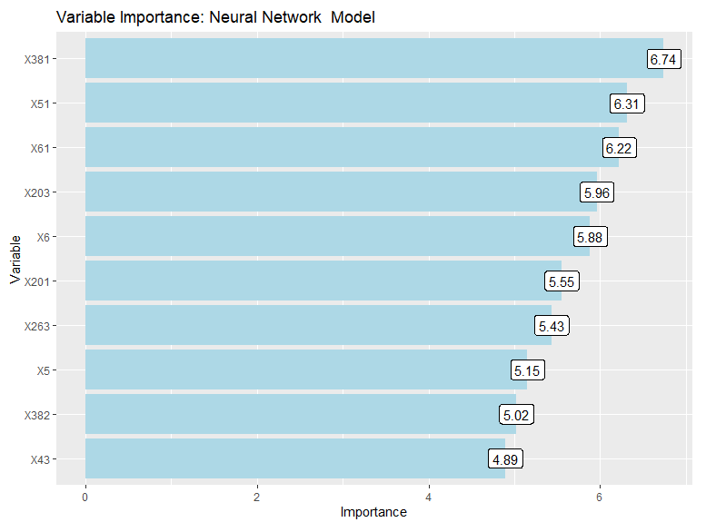
Neural Network model: Variable Importance

Slide 22
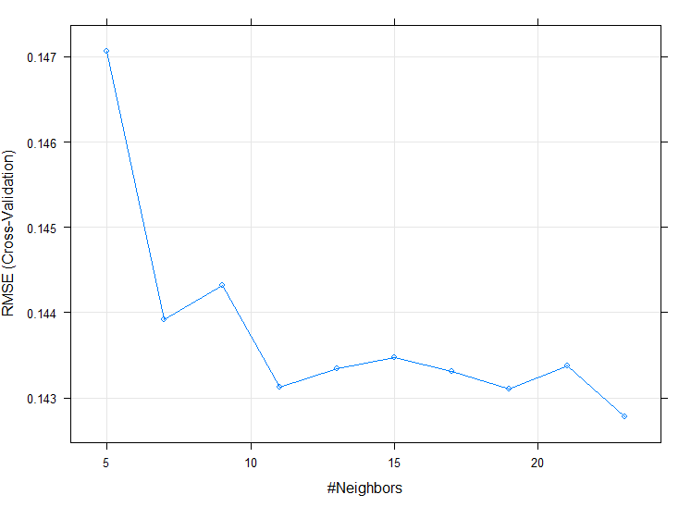
KNN model

Slide 23
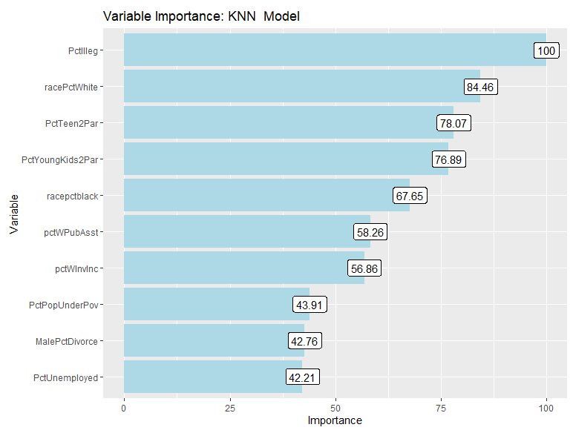
KNN model: Variable Importance

Slide 24
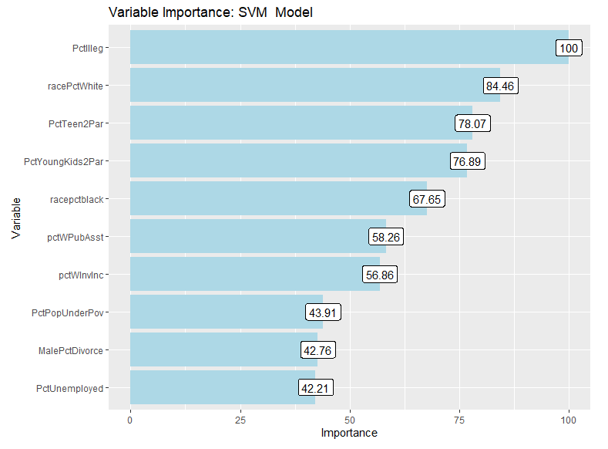
SVM model: Variable Importance

Slide 25
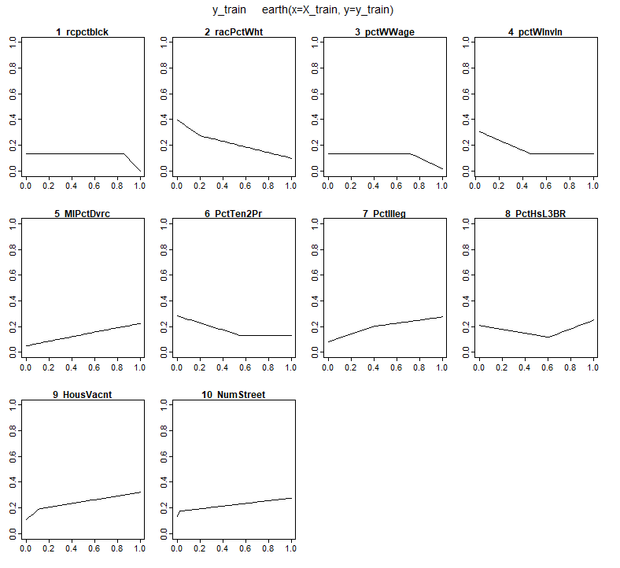
MARS model

Slide 26
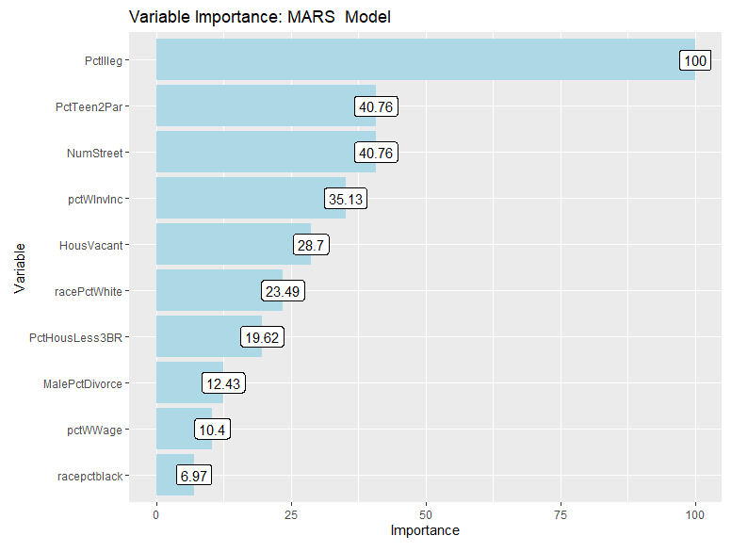
MARS model: Variable Importance

Slide 27
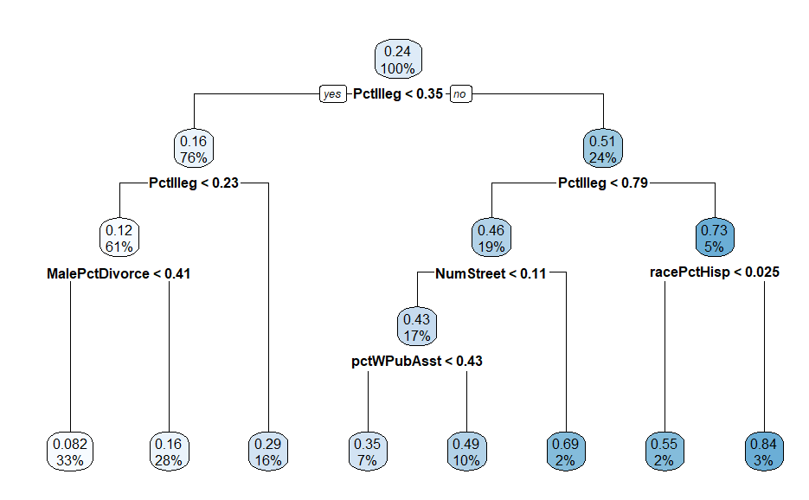
Decision Tree model

Slide 28
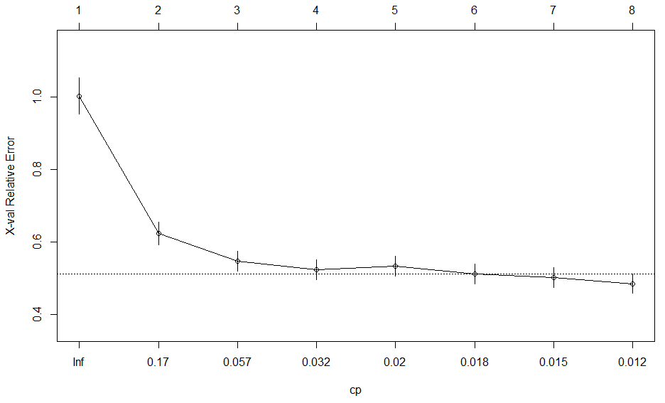
Decision Tree model

Slide 29
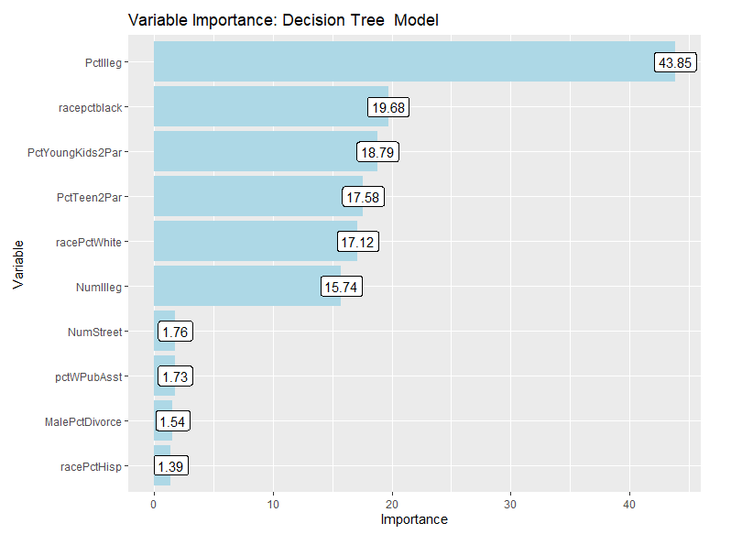
Decision Tree model: Variable Importance
The most important variable is PctIlleg: percentage of kids born to never married.

Slide 30
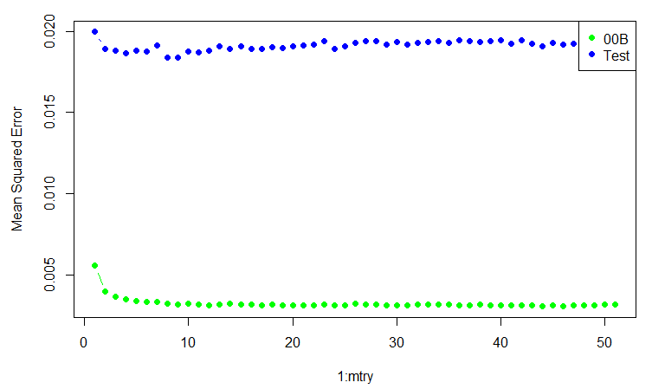
Random Forest model
In this case the test error seems to be greater than the OOB. The out-of-box error and test errors should line up.

Slide 31
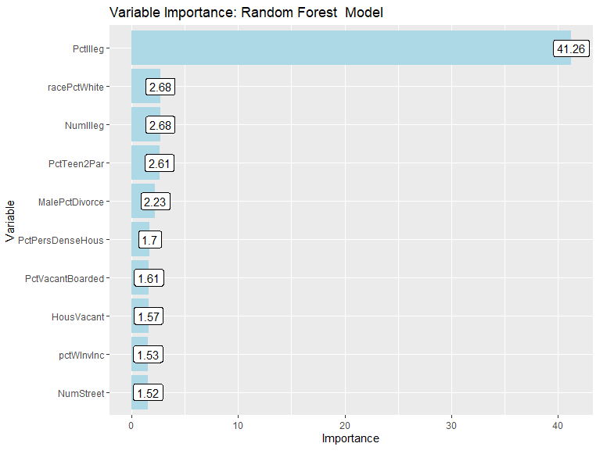
Random Forest model: Variable Importance
The most important variable is PctIlleg: percentage of kids born to never married.

Slide 32
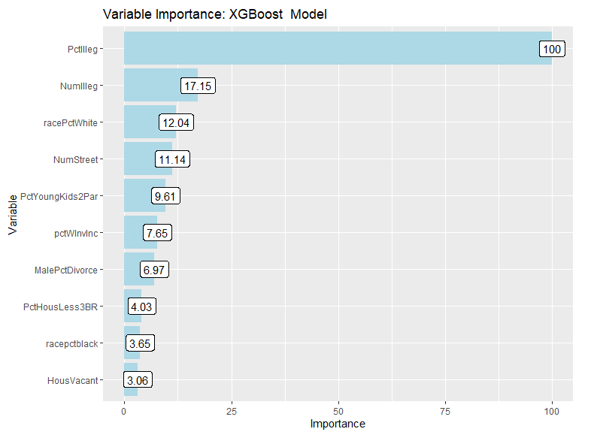
XGBoost model: Variable Importance
The most important variable is PctIlleg: percentage of kids born to never married.

Slide 33
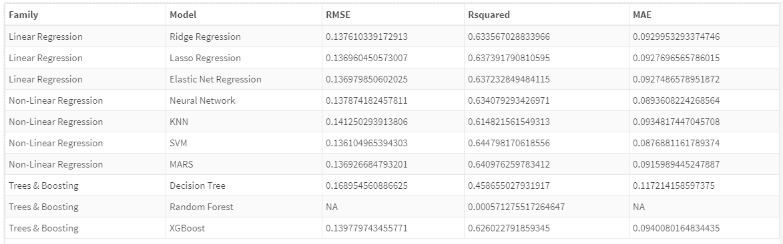
Summary models
All the models used are good with R2 greater than 60%, except for the simple decision tree model, which has an R2 of approximately 45.
We consider that the best model is the SVM model (Support Vector Machine) with RMSE 0.136 and R2 of 64.4%.

Slide 34
Conclusion
The different factors affect crime rates in our communities and states: Based on the data and data exploration conducted, we were able to analyze a large number of factors simultaneously to understand how the relationships between the different factors affect crime rates in our communities and states.
Percentage of children born whose parents were never married: We were able to observe that the percentage of children born whose parents were never married is a factor that considerably affects the percentage of violent crimes. While it is true that family structure can have some influence on children's behavior and development, delinquency is a complex problem that has multiple causes and cannot be attributed to a single factor.
Multiple causes: It is important to note that these are just a few of the possible causes of violent crime in communities across the United States, and that each case is unique and may have multiple contributing factors. Therefore, it is necessary to address these problems holistically and focus on finding specific solutions for each community. It is important to avoid stigmatizing certain groups in society and instead focus on understanding and addressing the underlying causes of crime so that effective and sustainable action can be taken to reduce it.

Slide 35
Resources:
https://www.kaggle.com/datasets/michaelbryantds/crimedata?select=crimedata.csv

